Slide 2
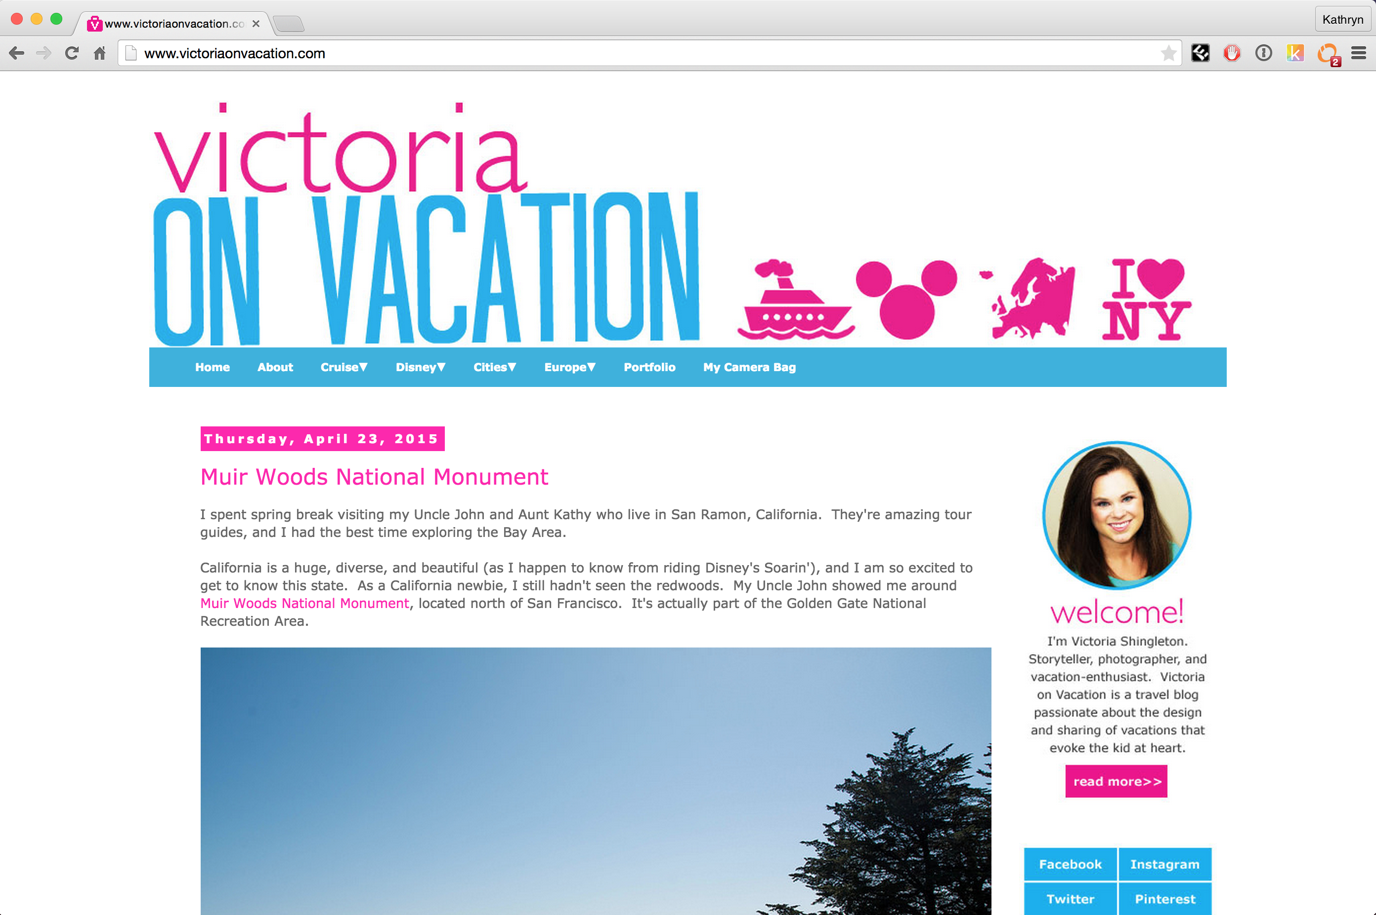
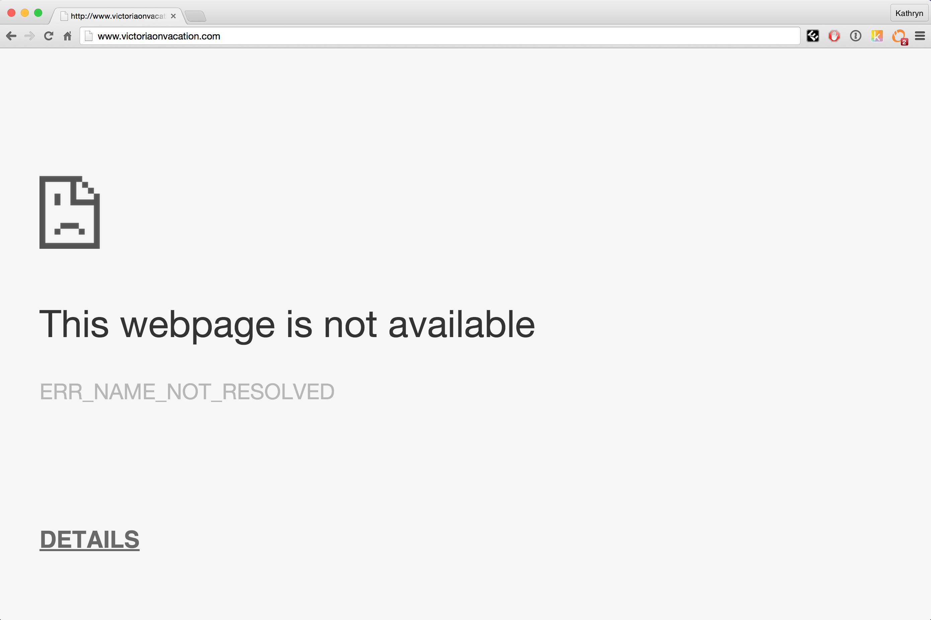

reddit hug of death
Millions of hits
Notes:
Server cannot respond to so many requests.

Slide 3
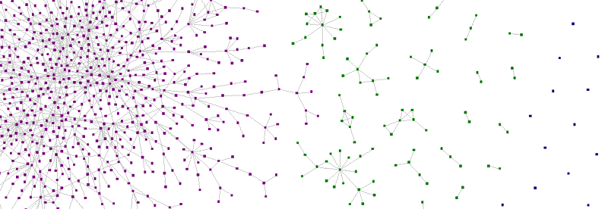
Zauberflöte: A Peer-to-Peer CDN
Anish Athalye, Ankush Gupta, Katie Siegel

Slide 4
Integration

Slide 5
Overview
Determine who has the resource
Open connection with peers
Request resource from peers
Advertise resource

Slide 6
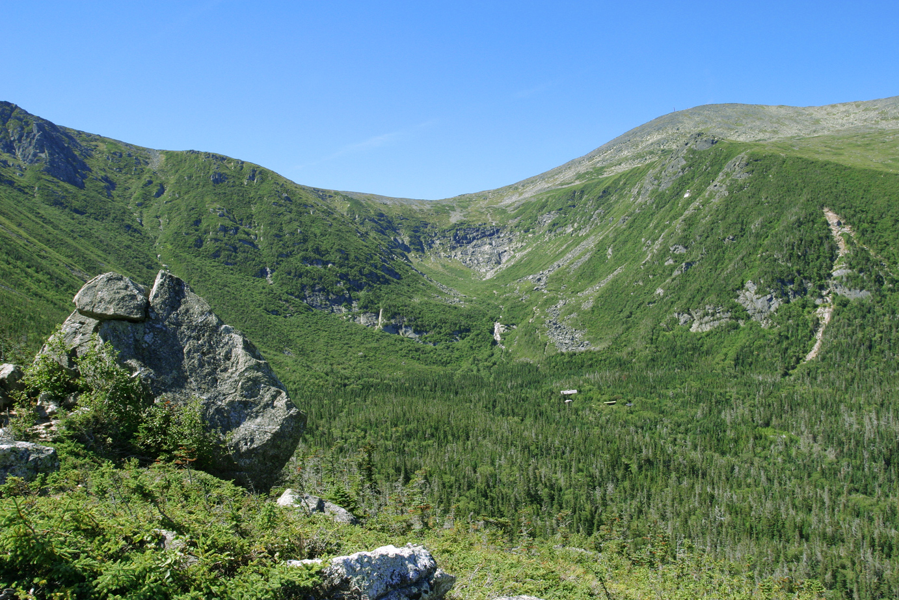
1. Determine who has the resource
SHA1 hash

Slide 7
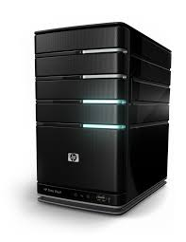

1. Determine who has the resource
{Hash}
Tracker
{Hash, Peers}

Slide 8

2. Open connection with peers

Slide 9
3. Request resource from peers
Data
{hash, chunk_num, payload}
Request
{hash, chunk_num}
Data
{hash, chunk_num, payload}
Request {hash, chunk_num}

Slide 10
4. Advertise Resource
Advertise
{hash}

Slide 11
Demo

Slide 12
Benchmarking
Measure load time of test page
Hosted server in VM
Kernel traffic shaping
Simulated “reddit effect”
Custom Scala driver
Selenium + ChromeDriver to launch browser windows
Inject JS for instrumentation

Slide 13
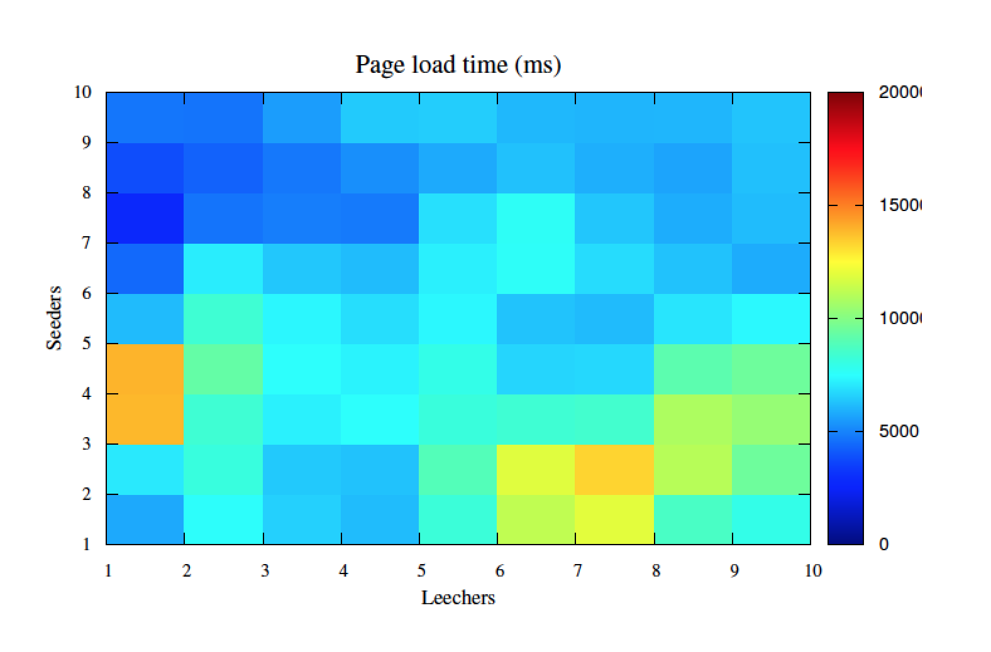
Page load times over P2P
20000
15000
10000
5000

Slide 14
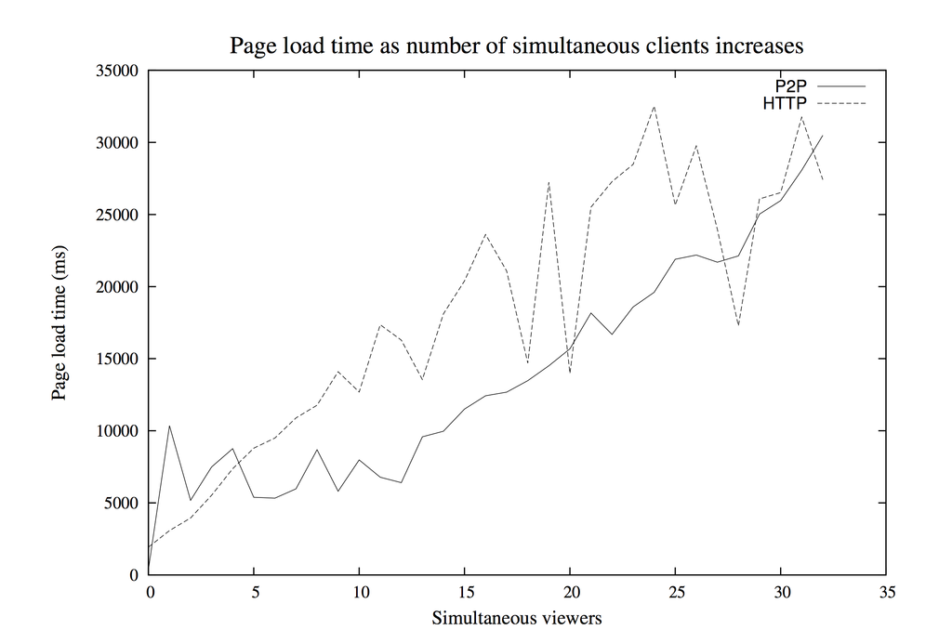

Slide 15
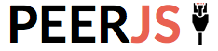


Alternatives
Notes:
Not open source, paid, not transparent

Slide 16
Questions?

